Slide 1
DATA TYPE
CLASS AND OBJECTS

Slide 2
Contents
Class & Object
Constructor
Access Specifier
Method
Variable

Slide 3
An Introduction to classes
A class is a building block of OOP.
It is the way to bind the data and its logically related functions together.
An abstract data type that can be treated like any other built in data type.
Class head ---------> class name_of_class.
Class body ---------> { data members;
member functions;
};

Slide 4
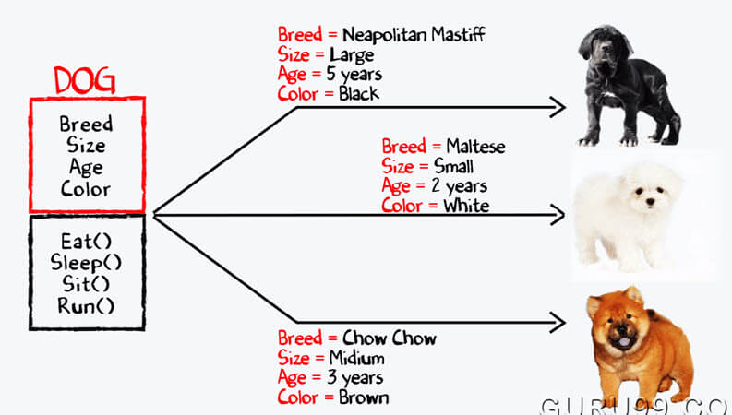
EXAMPLE:

Slide 5
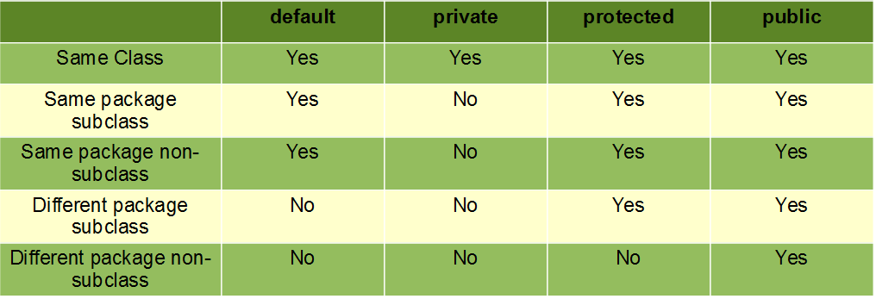
ACCESS SPECIFIER

Slide 6
CONSTRUCTORS
Constructor is a block of code that initializes the newly created object.
A constructor resembles an instance method in java but it's not a method as it doesn't have a return type.
Constructor has same name as the class and looks like this in a java code.
TYPES OF CONSTRUCTOR:
1. Default Constructor.
2. Non-Parameterized constructor
3. Parameterized Constructor

Slide 7
METHODS
A method is a block of code which only runs when it is called.
You can pass data, known as parameters, into a method.
Methods are used to perform certain actions, and they are also known as functions.
Syntax of method:
<access_specifier><return_type> method_name(parameter)

Slide 8
Introduction to objects
Object is an abstraction of real world entity
Objects are the variables/instances of classes.
Syntax for declaring objects is as follows :
<class name> <object name>= new constructor();
Example:
Person per=new Person();

Slide 9
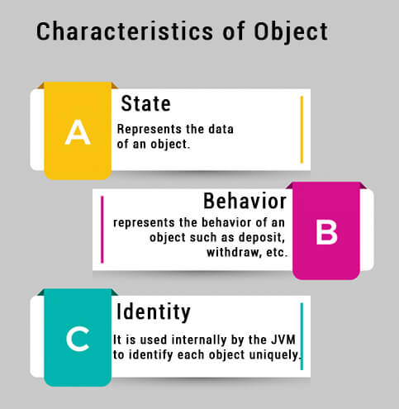
Characteristics of objects:
It can have its own copy of data members.
The scope of an object is determined by the place in which the object is defined.
It can be passed to a function like normal variables.
The members of the class can accessed by the object using the object to member access operator or dot operator(.).

Slide 10
CLASS AND LOCAL VARIABLE
In object-oriented programming with classes, a class variable is any variable declared with the static modifier of which a single copy exists, regardless of how many instances of the class exist.
A local variable in Java is a variable that's declared within the body of a method. Then you can use the variable only within that method. Other methods in the class aren't even aware that the variable exists.

Slide 11

THANK YOU

